Slide 1
Facial Recognition and Identification System
Devanshi Shah – 301175169
Shrikant Kale - 301150258
Jefil Tasna John Mohan - 301149710
Hitesh Dharmadhikari – 301150694
Nestor Romero Leon - 301133331

Slide 2
Abstract:
Introduction
Initial Exploration
Preprocessing
Clustering model selection
Artificial Neural Network
Metric
Predictions
Thank you

Slide 3
Introduction
The main objective of the project is to develop facial recognition and identification system using clustering techniques that could be incorporated into a law enforcement security company’s existing environment.
We are provided with the umist_cropped.mat dataset to train the machine learning model.

Slide 4

Initial exploration:
The Dataset has images of 20 different people.
The Images present in the dataset contains a different profile of their face
The dataset is imbalanced as it has a different number of images for each person
Total images of all persons in the dataset is 575

Slide 5
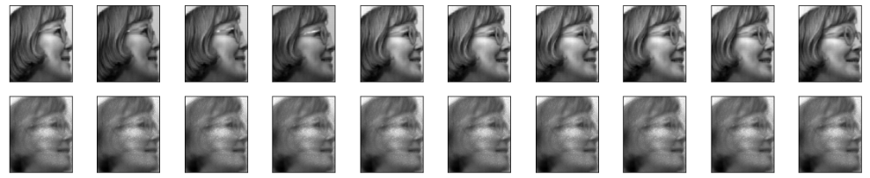
Preprocessing
Creating and testing an autoencoder to generate more images for one person in the dataset
The plot of the original versus reconstructed images generated by the testing model.

Slide 6
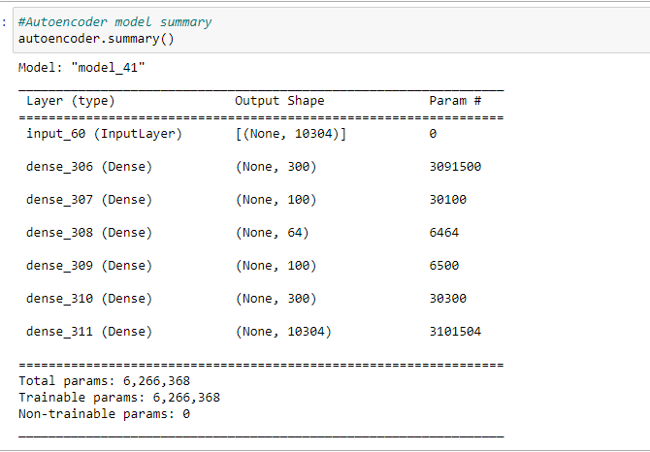
Preprocessing
Generating reconstructed Images for all people in the dataset using the autoencoder model to create 48 samples which are the highest in the dataset for all people.
This is achieved considering the total number of images for each person in the dataset.
Then mapping the inputs to the reconstructed images.
The reconstructed images are generated only for a person class with less than 48 images.
At the end, each person will have 48 images and the total number of images will be 48*20 = 960, which makes the data more balanced.

Slide 7
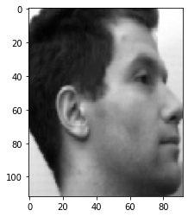
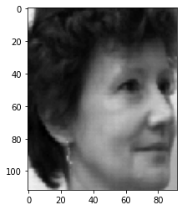
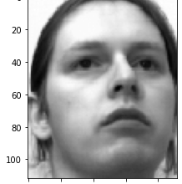
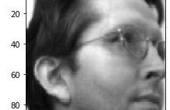
Preprocessing
Total Images = 48 per person (Total (48 x 20)= 960)
Train set - 30 Images per Person (Total (30 x 20) = 600)
Validation Set - 9 Images per person (Total (9 x 20) = 180)
Testing Set - 9 Images per person (Total (9 x 20) = 180)
Shuffling data so that it is not in sequential order

Slide 8
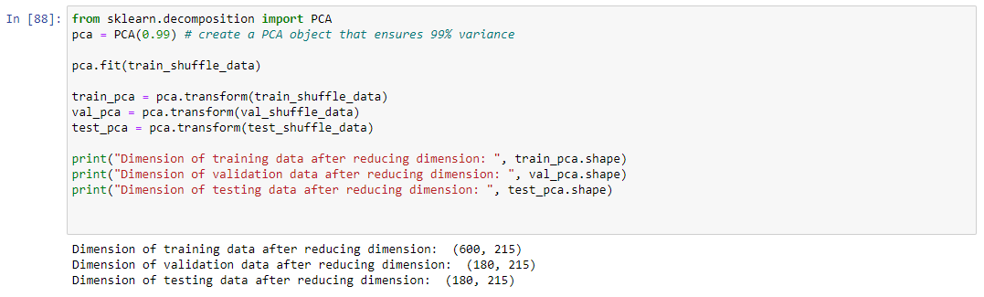
Preprocessing
Using PCA for dimensionality reduction preserving 99 % of the variance

Slide 9
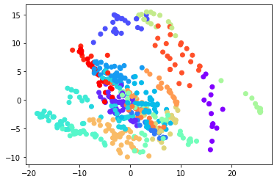
K-Means clustering
Choosing 20 as the optimal number of clusters based on elbow plot.

Slide 10
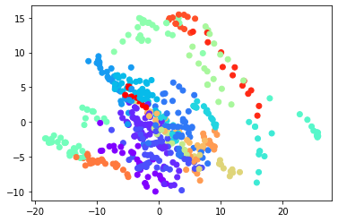
Agglomerative Hierarchical Clustering
The number of clusters determined by Agglomerative clustering is 20

Slide 11
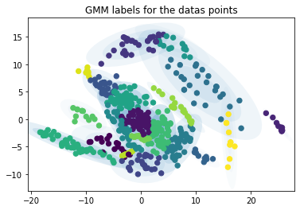
Gaussian Mixture Clustering
The dataset is fitting to the ellipsoidal shape instead of centering to the cluster.

Slide 12
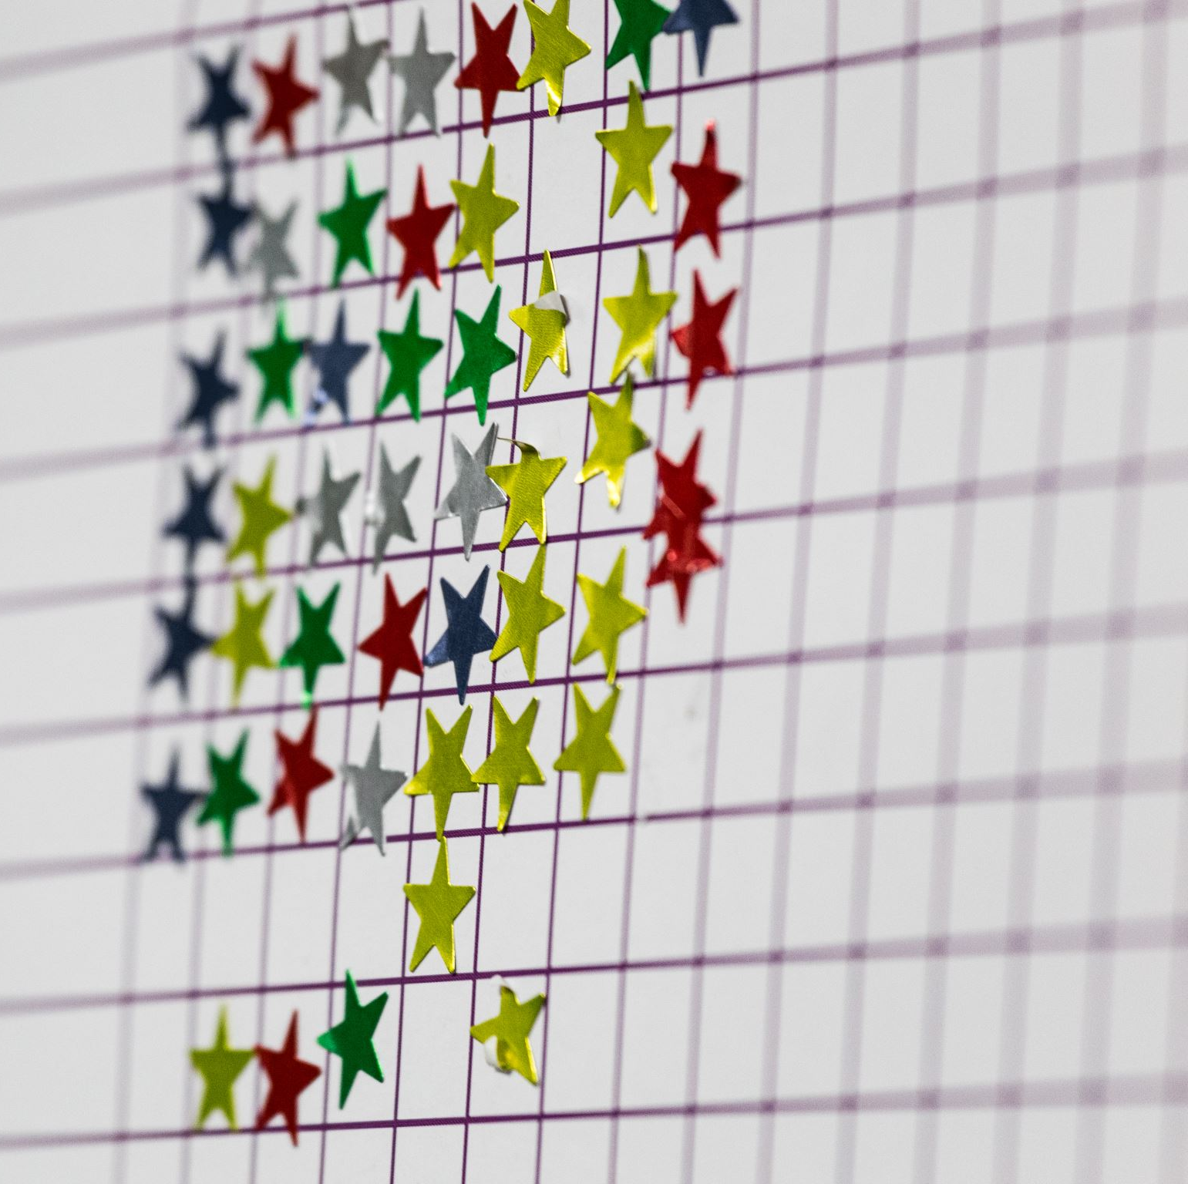
Model selected
GMM works better when clusters shape are ellipsoidal because it used gaussian mixture and covariance rather than only depending on the center of the cluster
It is generating less skewed data
It is generating the same number of labels for each person.
By running the classifier; using labels generated by all clustering techniques we found higher accuracy consistently when we used labels generated by GMM.

Slide 13
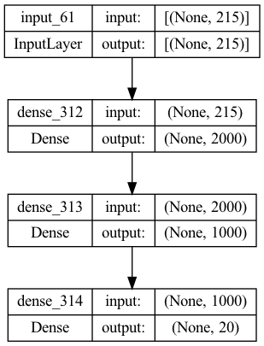
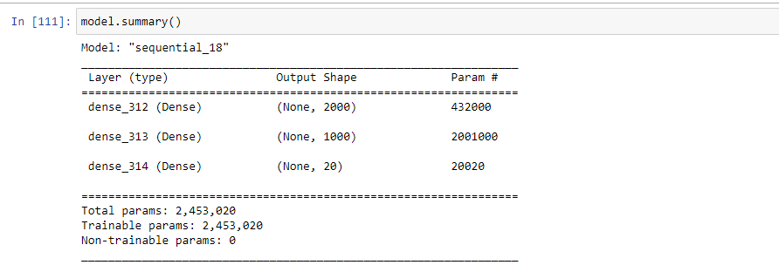
Artificial Neural Network
Using the training features in 'train_pca' and its actual labels in 'test_labels' variable
We are training the ANN model to make predictions

Slide 14
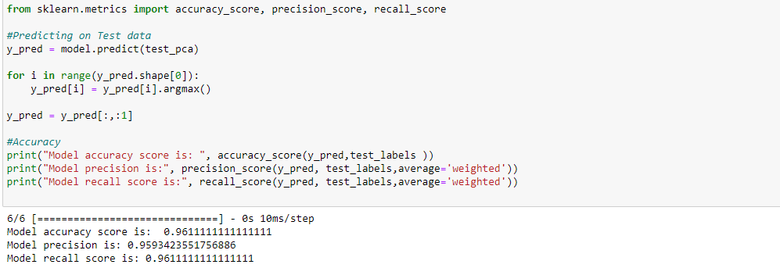
Metrics
Model accuracy score is: 0.9611111111111111
Model precision is: 0.9593423551756886
Model recall score is: 0.9611111111111111

Slide 15
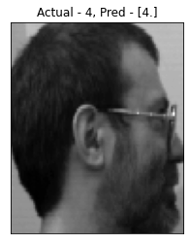
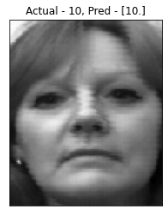
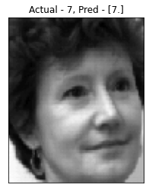
Predictions:
Here are some predictions from our model.

Slide 16
Thank you

